Slide 1
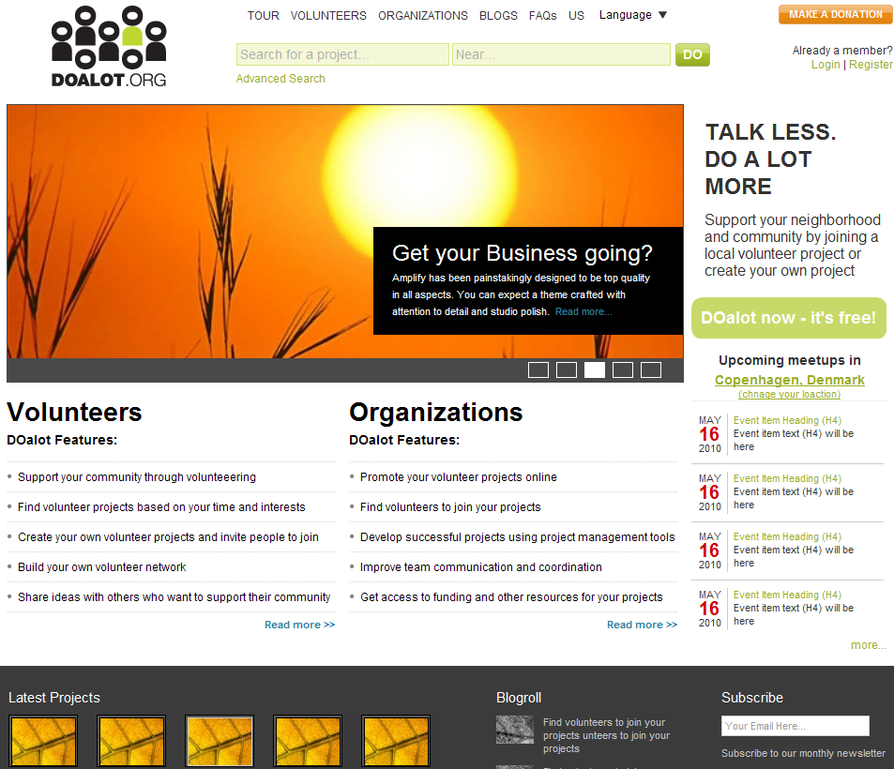
When mousing over the ‘Change your location’ then ‘Change your location should become underlined and ‘Copenhagen, Denmark’ should become bold
Text correction:
Change your location
Each blog should be a link

Slide 2
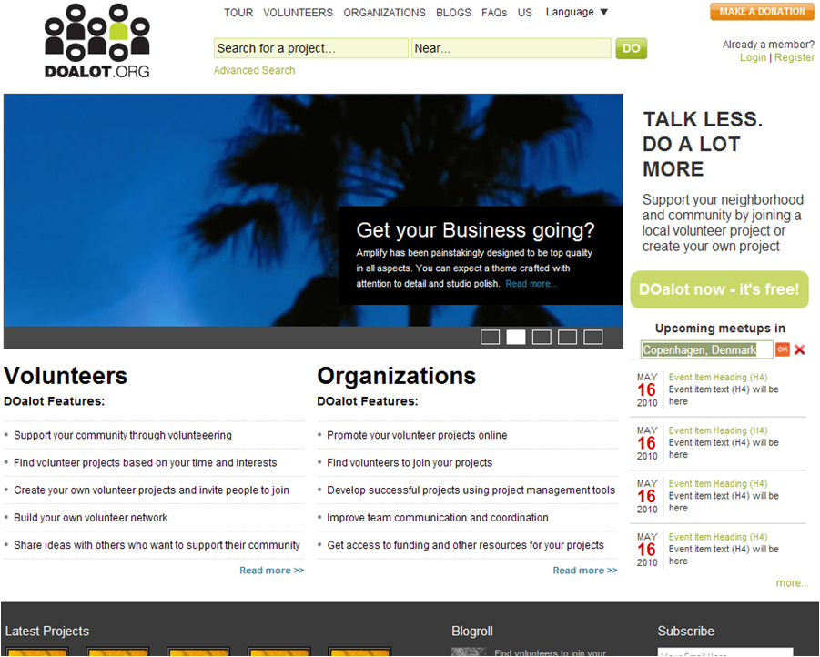
Move the ‘OK’ button outside the data field (as shown here)

Slide 3
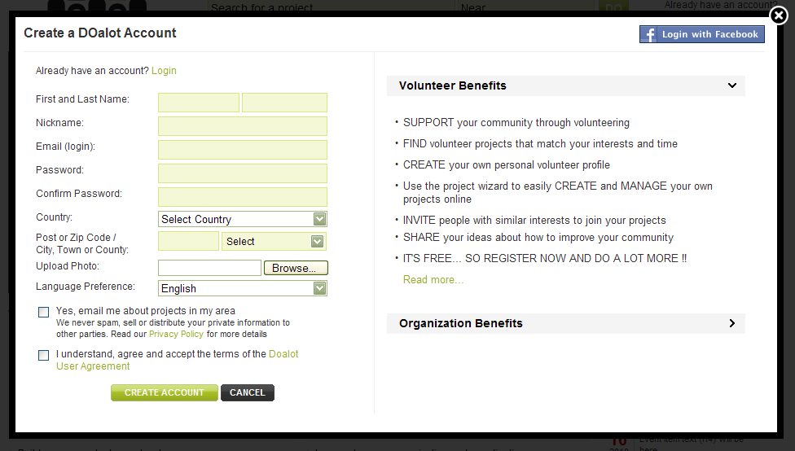
When clicking on these links the section should slide down

Slide 4
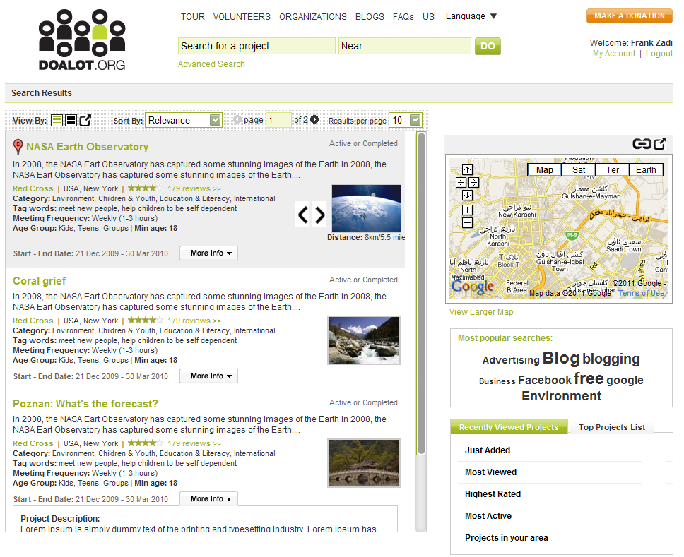
The ‘My Account’ link isn’t working
The arrows should not have any white areas around them
There should not be any ‘white’ areas around the links pictures. They should be transparent
The Distance should be on the same line as ‘Start – End Date’ and placed here
Remove this link
Change scroll bar style – see http://www.hesido.com/web.php?page=customscrollbar
Also, make the scrollbar more narrow than shown here
Use this scrollbar style for all pages
The map is expanding too large when it opens. It should only open as far as it did on previous versions that you made
When I open the ‘More Info’ button on tops the box opens up down here

Slide 5
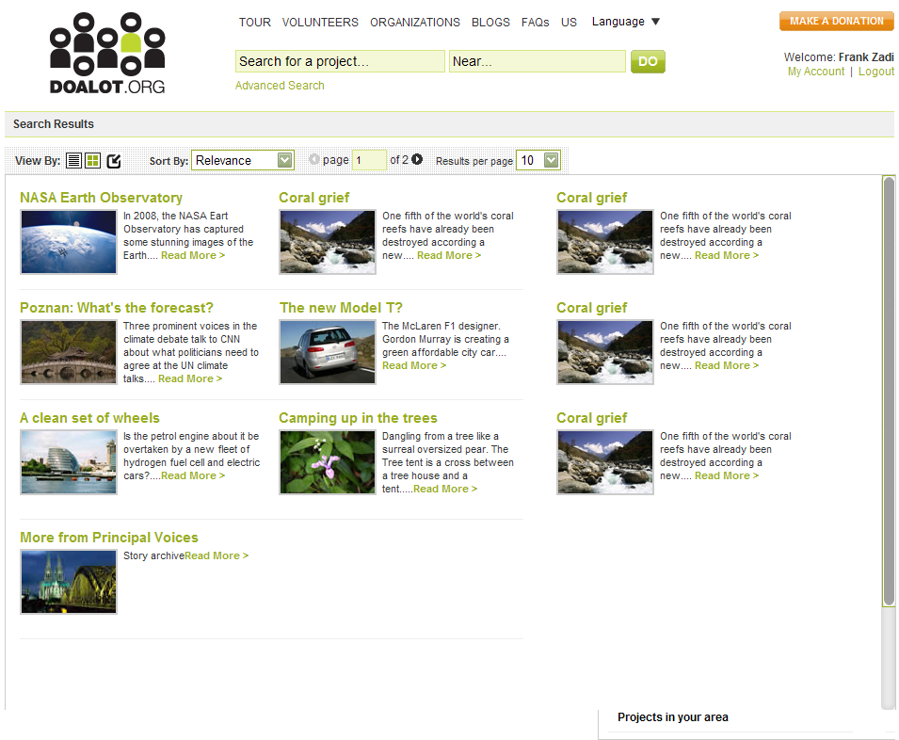
This section should not be shown when the page expands

Slide 6
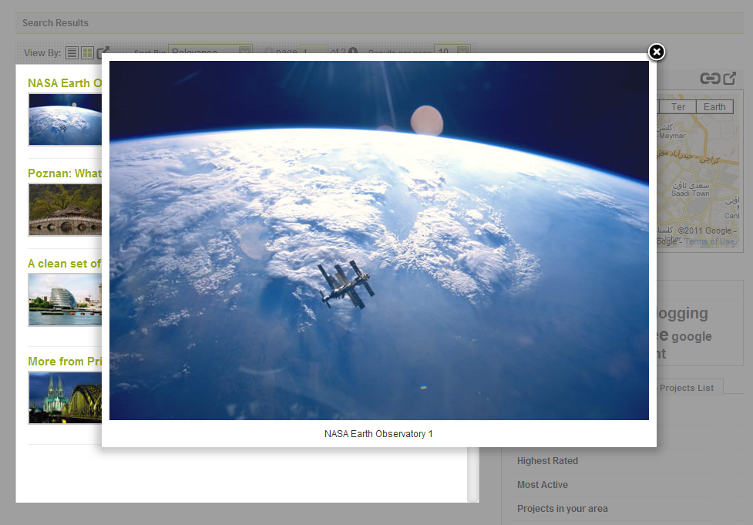
When opening the lightbox this background should be greyed out and disabled
Change the picture gallery back to the one you used earlier: http://www.webtoseo.com/projects/doalot/html-5feb-11/html/projectSearchResults.html

Slide 7
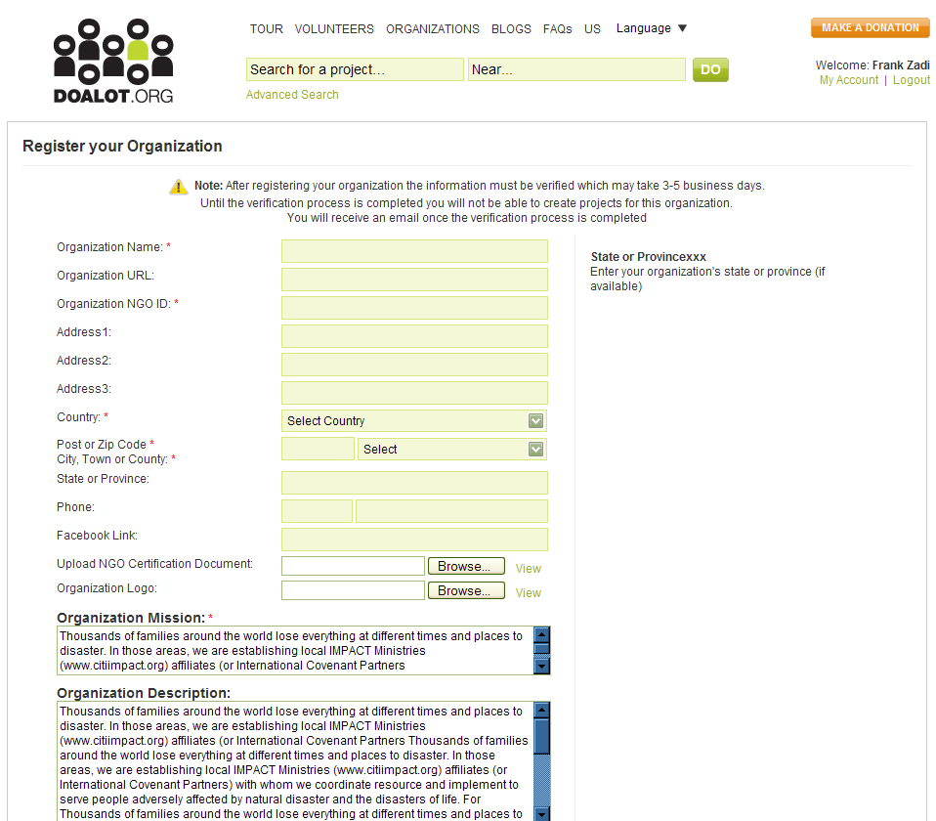
Remove text: ‘xxx’
Why is the scroll bar look like this?

Slide 8
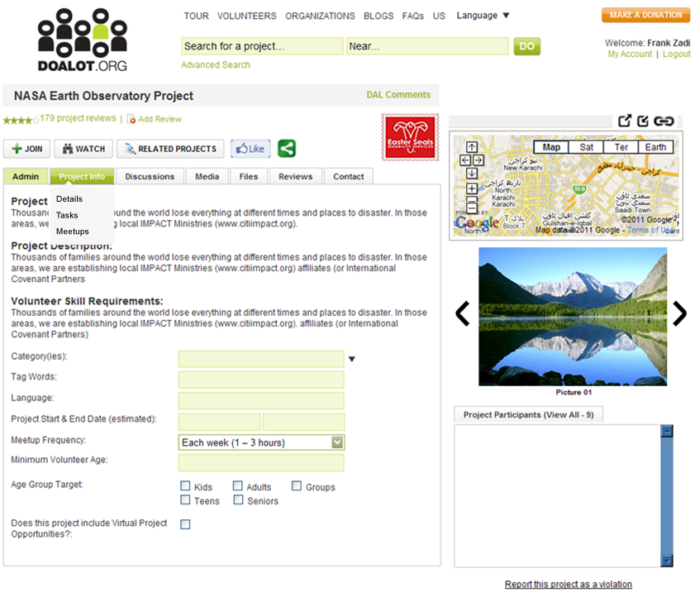
The Meetups sub menu doesn’t work
There should not be any ‘white’ areas around the links pictures. They should be transparent
Nothing should happen when clicking on the ‘Project Info’ tab
The map is expanding too large when it opens. It should only open as far as it did on previous versions that you made
Change the dropdown menu style to something like this (the menu should slide down on mouseover)
This slideshow doesn’t work

Slide 9
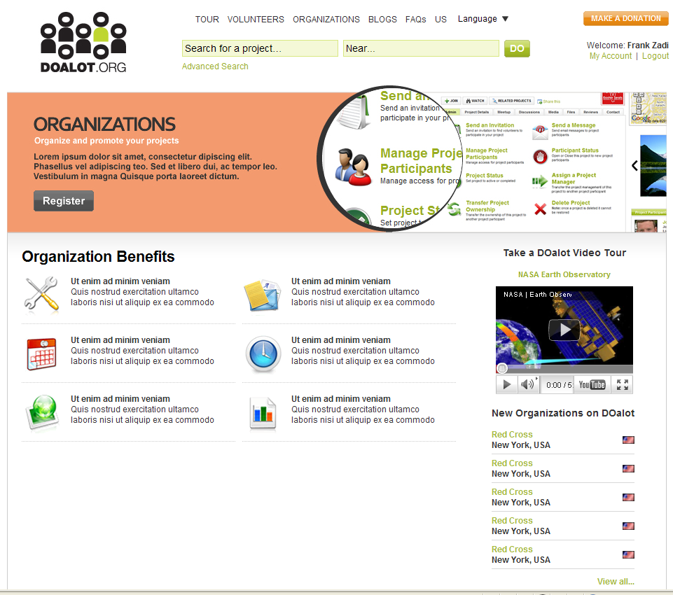
The text ‘Join’ should be in this size and font style (above)

Slide 10
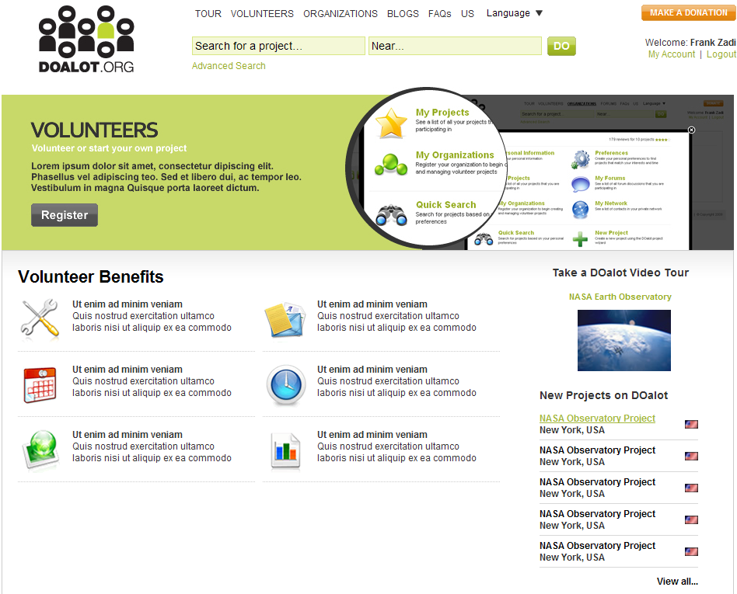
The text ‘Join’ should be in this size and font style (above)

Slide 11
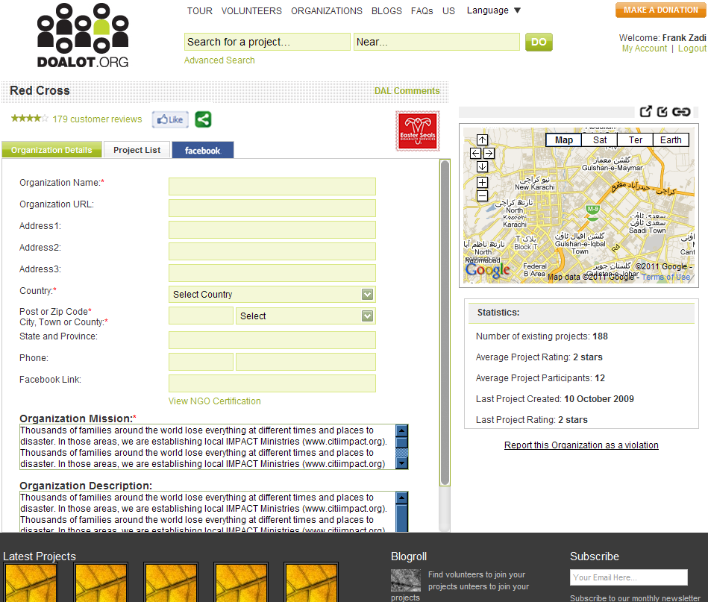
There should not be any ‘white’ areas around the links pictures. They should be transparent
The map is expanding too large when it opens. It should only open as far as it did on previous versions that you made

Slide 12
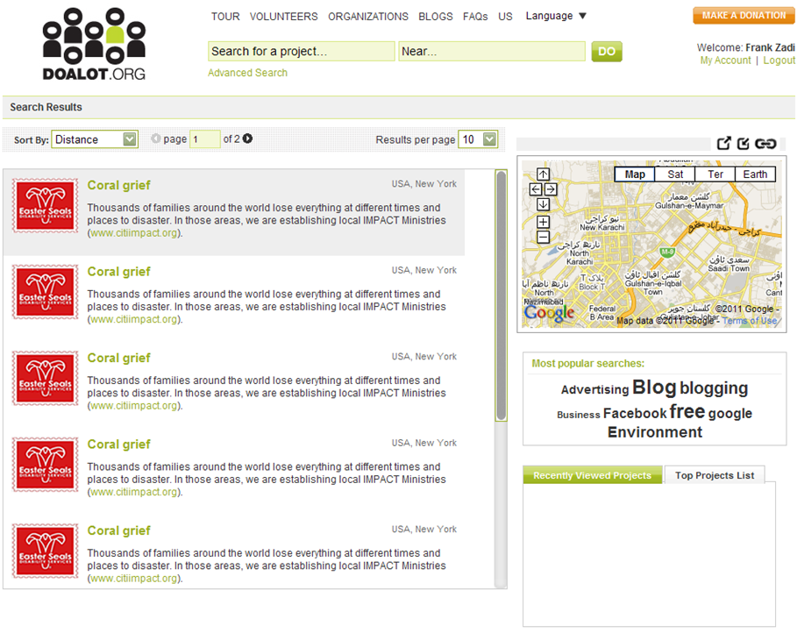
There should not be any ‘white’ areas around the links pictures. They should be transparent
The map is expanding too large when it opens. It should only open as far as it did on previous versions that you made

